Slide 1
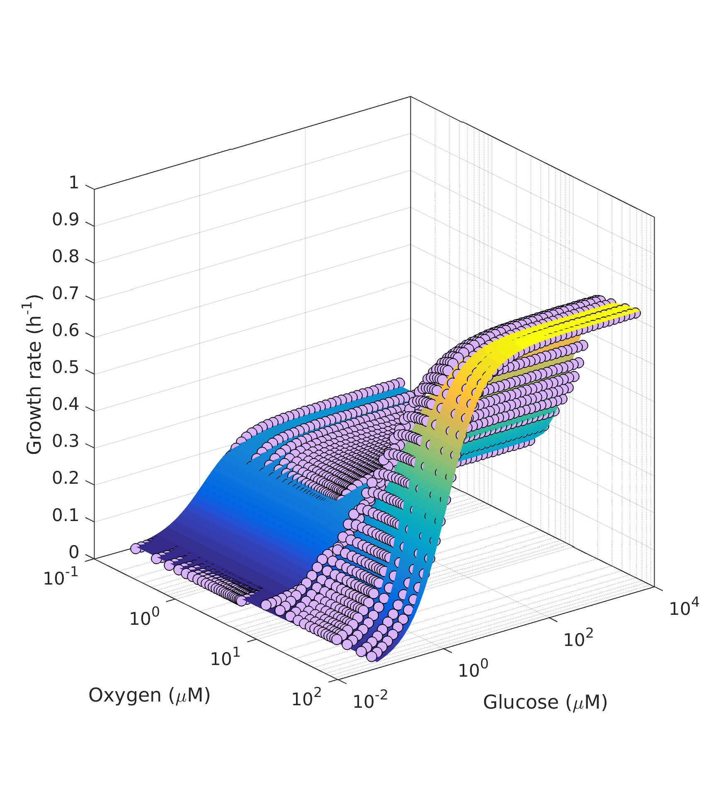
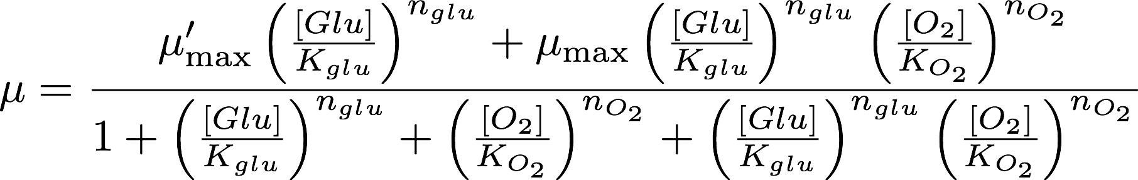
Violet dots: simulation using Matsuoka2017model
Surface: best fit using the following model
Note: the fastest growth rate is about 54 min/generation. Do not know why yet.

